Slide 1

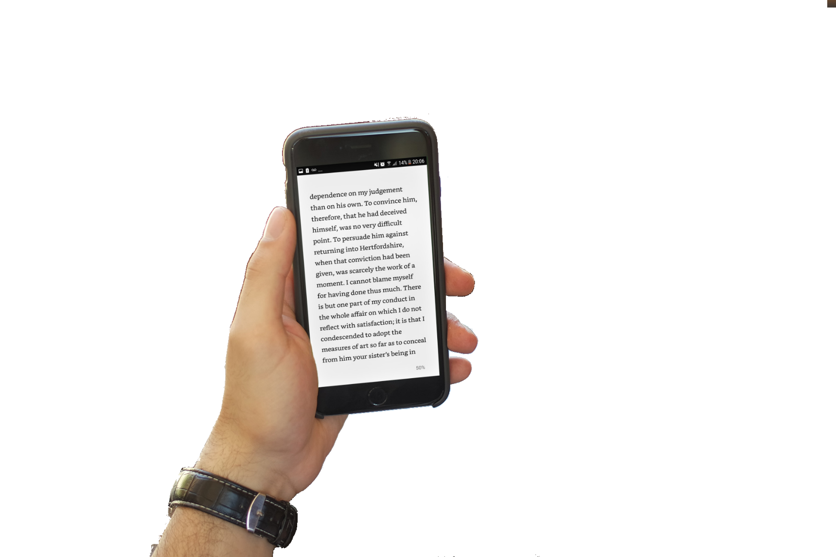
Encrypt Studio
Keep your passwords and messages safe
Bookipedia
Open mobile library

Slide 2

Encrypt Studio
Keep your passwords and messages safe

